Slide 2
INTRODUCTION

Slide 3
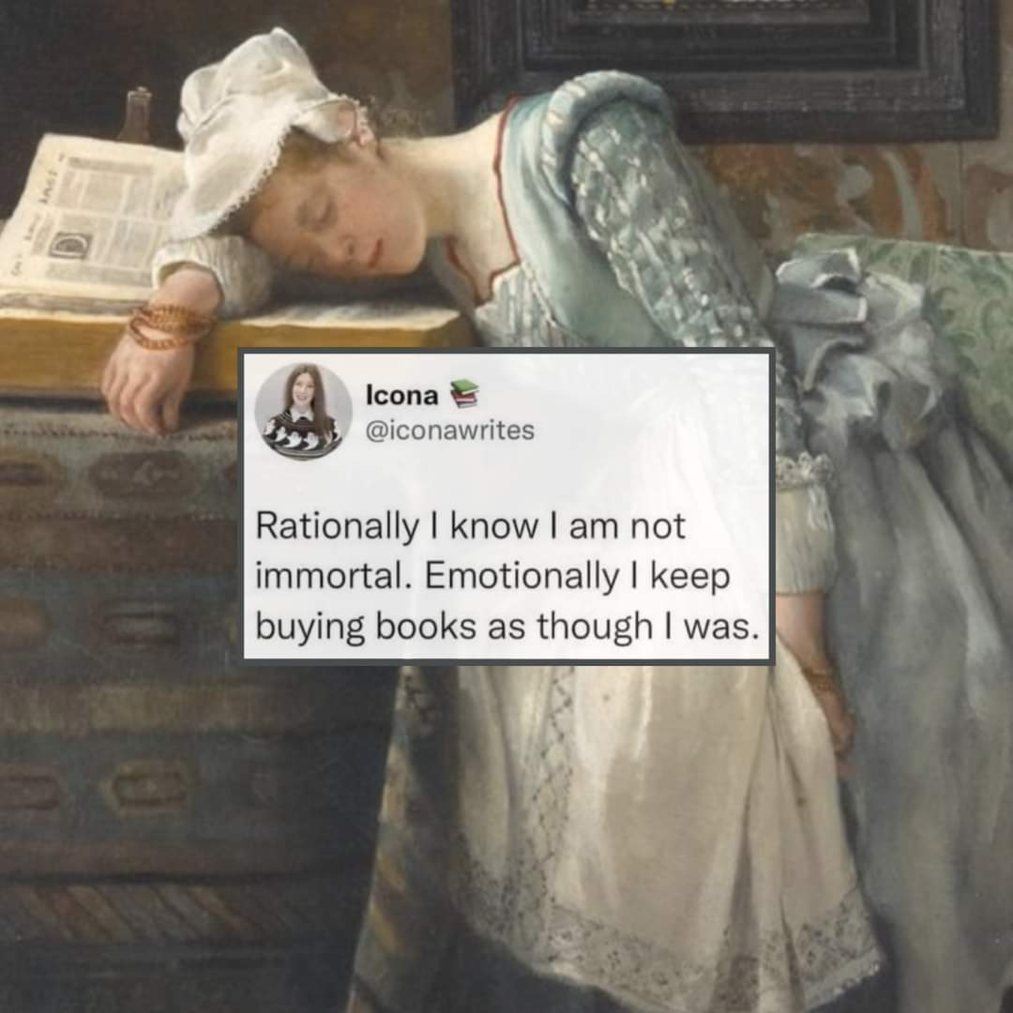

Slide 4
Chapter 1
WHY STORY?

Slide 5
Why are stories so powerful?
What makes a great story?

Slide 7
Your eyes saw my unformed body; all the days ordained for me were written in your book before one of them came to be.
Psalm 139:6 (NIV)

Slide 8
Chapter 2
GOD’S STORY

Slide 9
The Bible is God’s way of revealing the greatest story on earth.

Slide 10
Getting to know God’s story
Word Search

Slide 11
For whatever was written in earlier times was written for our instruction, so that through endurance and the encouragement of the Scriptures we might have hope and overflow with confidence in His promises.
Romans 15:4 (AMP)

Slide 12
God’s story = a life story leading to eternal life

Slide 14
Chapter 3
HER STORY

Slide 15
Wonderful Women
What does the story tell me about her?
What does the story tell me about God?
What does the story teach me about my life and relationship with God?

Slide 17
Psalm 20
(Aimee version)

Slide 18
God’s story = a life story leading to eternal life
Her story = a life story that teaches me about life

Slide 19
Chapter 4
MY STORY

Slide 21
Why tell your story?

Slide 22
Ways to tell your story

Slide 23
Honour Christ and let him be the Lord of your life. Always be ready to give an answer when someone asks you about your hope.
1 Peter 3:15 (CEV)

Slide 24
God’s story = a life story leading to eternal life
Her story = a life story that teaches me about life
My story = a life story of a life well-lived

Slide 26
Chapter 5
THE STORIES WE TELL OURSELVES

Slide 27
We take hold of every thoughts and make it obey Christ.
2 Corinthians 10:5 (NIV)

Slide 28
The stories we tell ourselves are powerful

Slide 29
Tools to train our thinking

Slide 30
Do not conform to the pattern of this world, but be transformed by the renewing of your mind. Then you will be able to test and approve what God’s will is—his good, pleasing and perfect will. Romans 12:2(NIV)

Slide 31
So here’s what I want you to do, God helping you: Take your everyday, ordinary life—your sleeping, eating, going-to-work, and walking-around life—and place it before God as an offering. Embracing what God does for you is the best thing you can do for him. Don’t become so well-adjusted to your culture that you fit into it without even thinking. Instead, fix your attention on God. You’ll be changed from the inside out. Readily recognize what he wants from you, and quickly respond to it. Unlike the culture around you, always dragging you down to its level of immaturity, God brings the best out of you, develops well-formed maturity in you. Romans 12:2 (The Message)

Slide 32
Finally, brothers and sisters, whatever is true, whatever is noble, whatever is right, whatever is pure, whatever is lovely, whatever is admirable—if anything is excellent or praiseworthy—think about such things.
Philippians 4:8 (NIV)

Slide 34
Chapter 6
LISTENING

Slide 36
Listening
To God’s story
To Her story
To My story

Slide 37
Holding space for each other

Slide 38
There is a time for finding and losing, keeping and giving, for tearing and sewing, listening and speaking. Ecclesiastes 3:6,7 (CEV)

Slide 39
Tips for great listening

